Slide 1






Foundations of
Quantum Information Science (QIS 101)
Dave Biersach
Brookhaven National Laboratory
dbiersach@bnl.gov
Session 16b
Scientific Computing

Slide 2
Session 16b – Goals
Leverage Open Data Sets to investigate atomic stability and the liquid range of elements
Review the Python Dictionary class, including methods to create, read, update, and delete keys and values
Serialize and rehydrate a JSON data file as a Python Dictionary
Implement methods for interpolating multi-dimensional data taken from randomly distributed locations
Analyze the mathematics of the Inverse Distance Weighting (IDW) method to convert non-uniformly measured spatial data to a regular conforming mesh
Use the Root Mean Square Deviation (RMSD) statistic as a measure of model accuracy

Slide 3
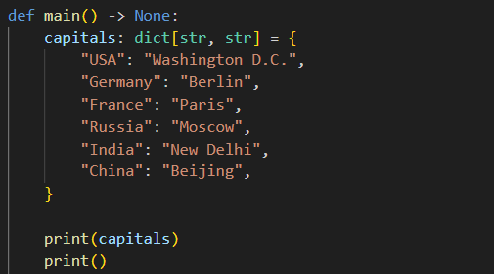
Open python_dictionaries.py
①
②
"Key-Value Pairs"
Keys
Values
③
④

Slide 4
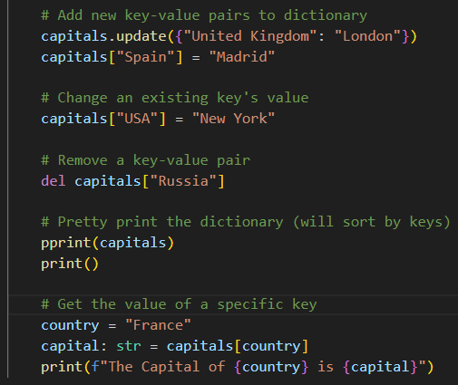
View python_dictionaries.py
①
②
③
④
⑤
⑥

Slide 5
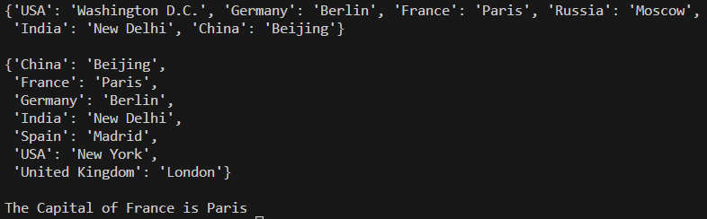
Run python_dictionaries.py

Slide 6
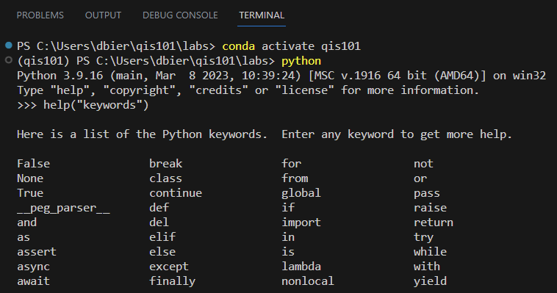
Python Interpreter (REPL)
①
②
③
Read-Eval-Print-Loop
An interactive, top-level, language "shell"

Slide 7
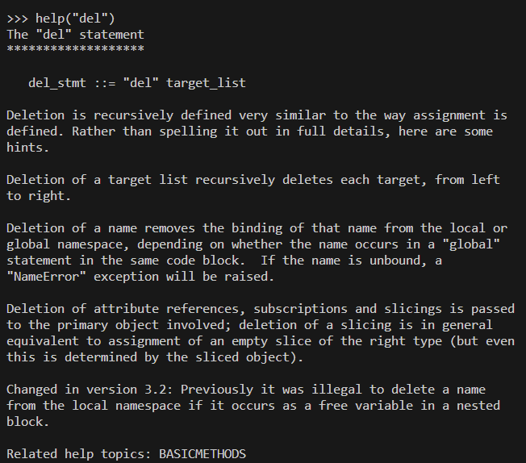
Python Interpreter (REPL)
①

Slide 8
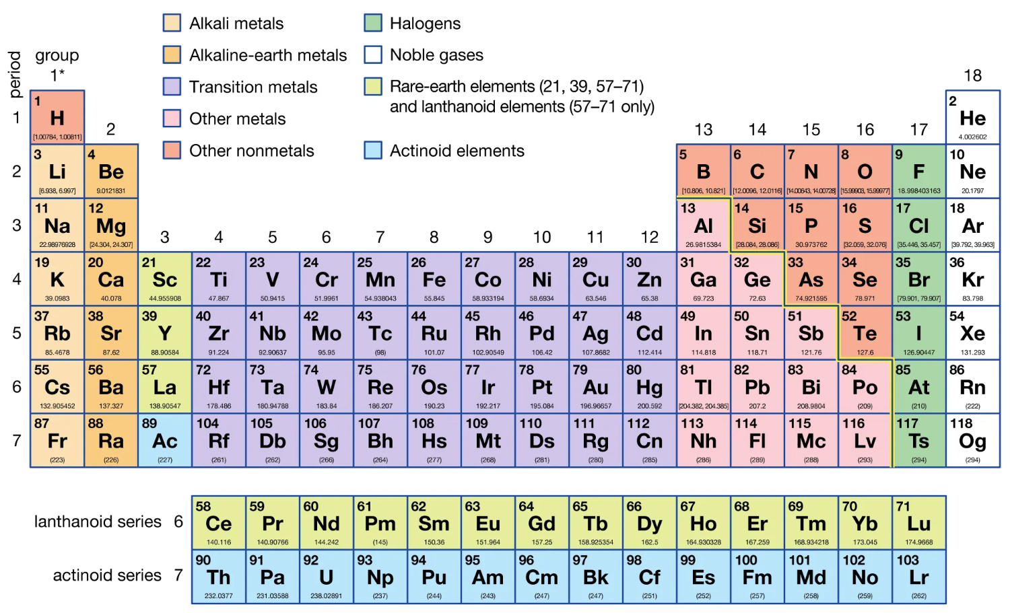
The Periodic Table
U-238
# of Protons = 92
# of Neutrons = 146

Slide 9
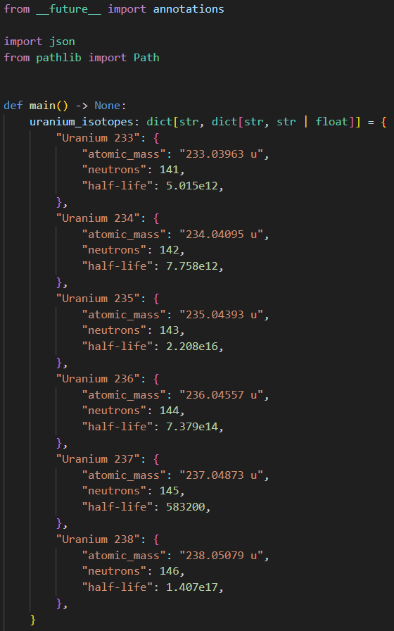
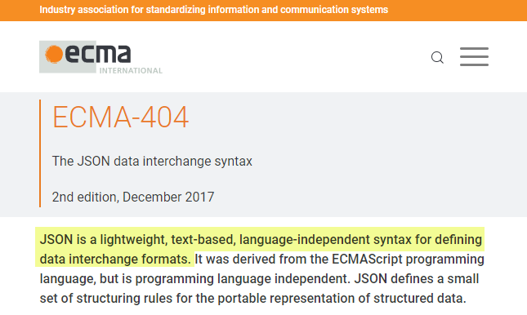
Open write_json.py
①
②
A nested dictionary
③
④
⑤
JavaScript Object Notation (JSON)
⑥
https://www.json.org
⑦
"Key-Value Pairs"
⑧

Slide 10
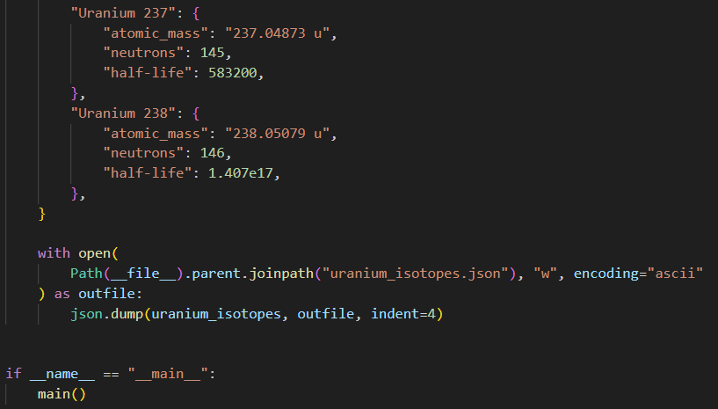
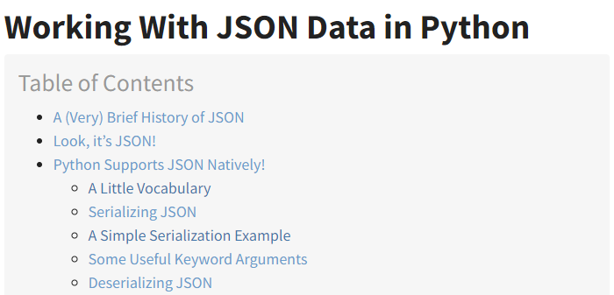
View write_json.py
https://realpython.com/python-json
①
③
④
②

Slide 11
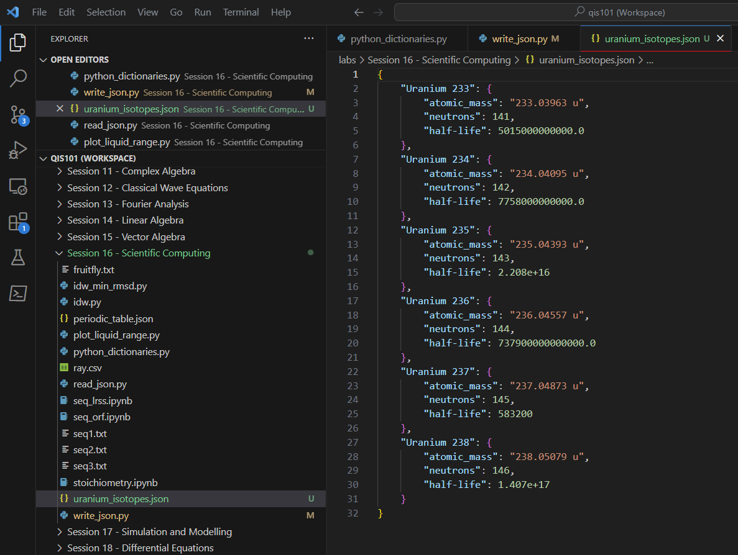
Run write_json.py

Slide 12

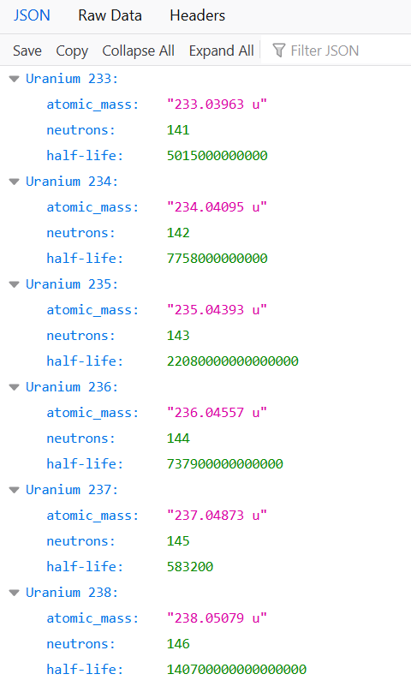
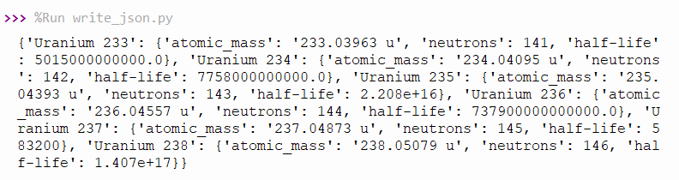
JSON in Firefox

Slide 13
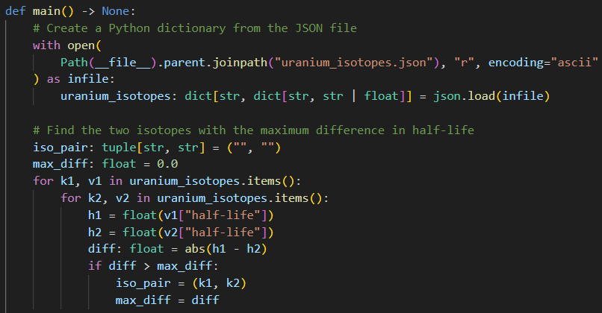
Open read_json.py
Which two isotopes of Uranium differ the most in half-life?
①
②
③
④
⑤
"Key-Value Pairs"
⑥
⑦
⑧
⑨
⑩

Slide 14
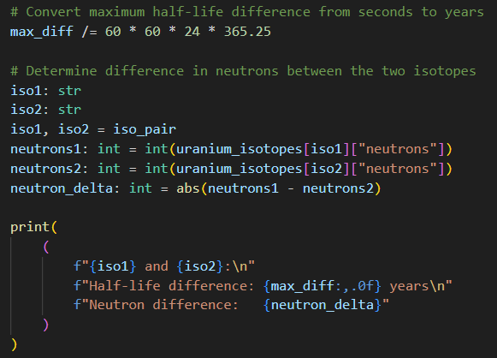
View read_json.py
①
②
③
④
⑤

Slide 15
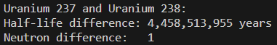
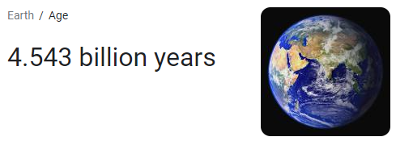
Run read_json.py
①
②
③
One tiny neutron can make a world of difference

Slide 16
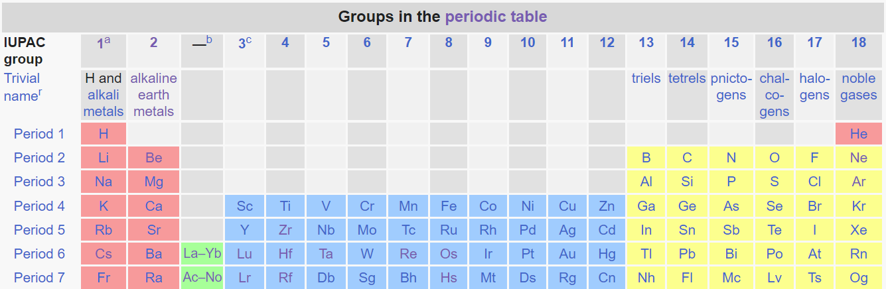
The Periodic Table (2021)
All elements in a group have the same number of valence electrons. As a result, elements in the same group often display similar properties and reactivity.
All elements in a period have the same number of electron shells. Each next element in a period has one more proton and is less metallic than its predecessor.

Slide 17
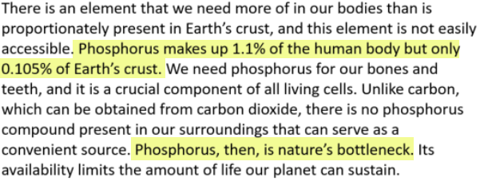
One Element
https://wou.edu/chemistry/courses/online-chemistry-textbooks

Slide 18
"It's not what you look at that matters, it's what you see." Henry David Thoreau (1846)
Scientists have measured the various electrical impulses traveling up the major nerves stemming from our eyes, ears, nose, tongue, and skin that ultimately signal our brain
We have determined that more than 80% of our total sensory input comes from our eyes – we are an extremely visual species
Humans do poorly at spotting trends in tabular data whereas graphical charts allow us to see trends and quickly spot anomalies
The boring old periodic chart is full of surprising artwork if we can find ways to better visualize the data

Slide 19
Highs & Lows and Unexpected Jumps
Your scientist has asked you to plot the melting and boiling point of each element across the periodic chart
She is interested in visualizing any trends and discontinuities in elements having the same valence shell structure
Therefore, she wants you to plot the elements first by group, then by period, then by atomic number order
She has asked you to include elements from both the Lanthanoid and Actinoid series
Is there a readily available JSON data set on the web that encodes the periodic chart?

Slide 20
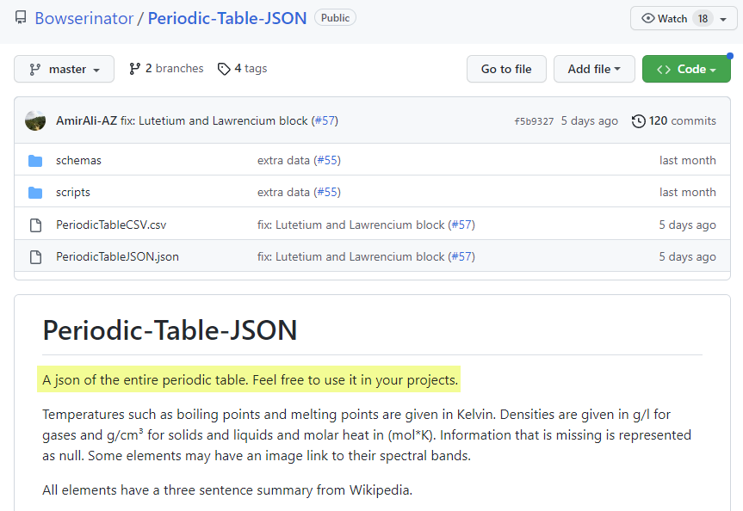
The Periodic Table as JSON
https://github.com/Bowserinator/Periodic-Table-JSON

Slide 21
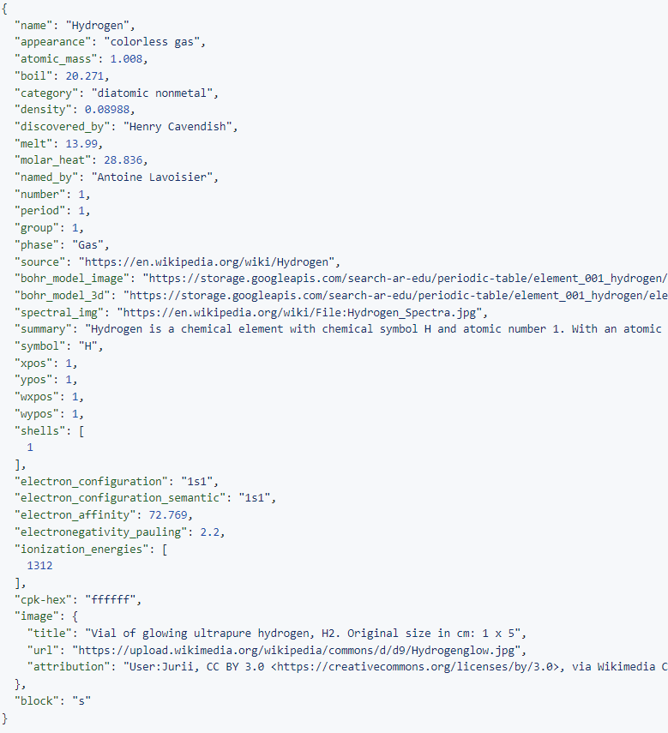
⑥
periodic_table.json
⑤
JSON is like a
Python dictionary with keys and values
②
④
③
①
All temperatures in Kelvin
A value can itself be a "nested" dictionary

Slide 22
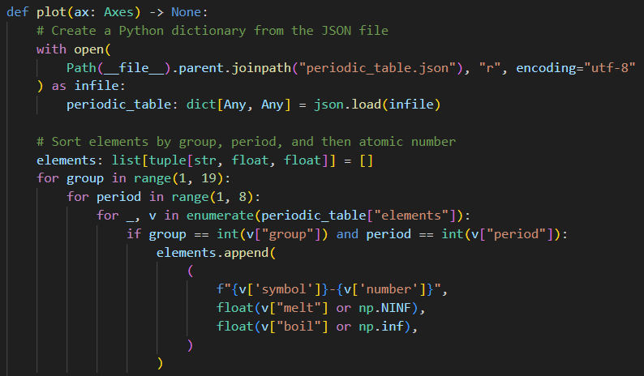
Open plot_liquid_range.py
①
②
③
④
⑤
⑥
⑦
Index # 0
⑧
Index # 1
⑨
Index # 2
⑩

Slide 23
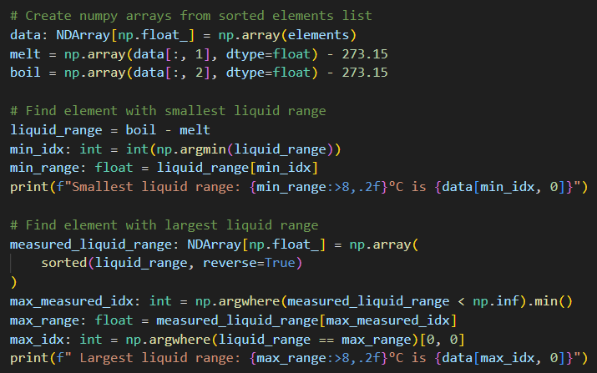
View plot_liquid_range.py
①
②
③
⑤
④
⑥
First index
⑦
⑧
⑨
⑩

Slide 24
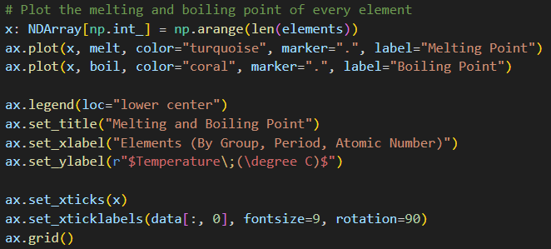
View plot_liquid_range.py
①
②
③
④
⑤
⑥
⑦
⑧

Slide 25
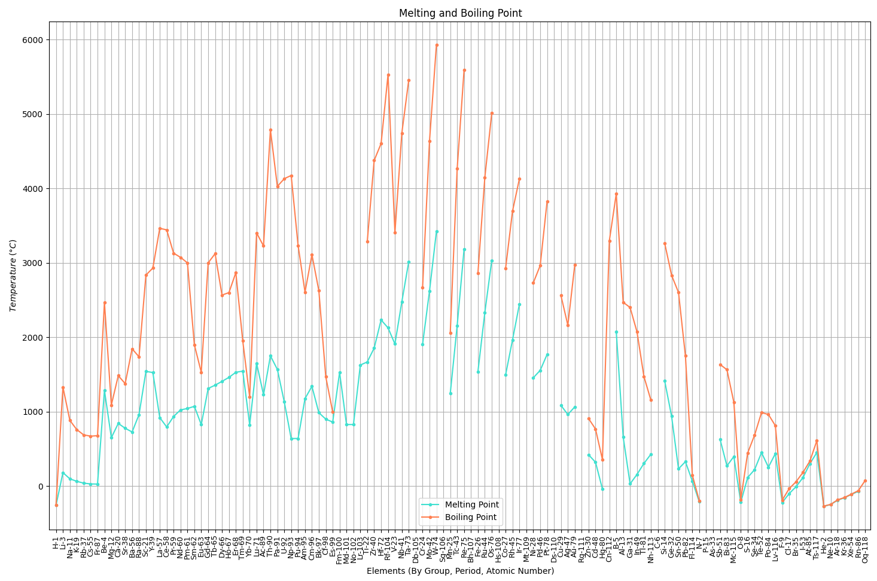
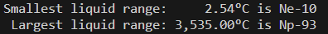
Run plot_liquid_range.py
Neptunium has the largest liquid range of any element
Neon has the smallest liquid range of any element

Slide 26
Carbon doesn't have a melting point (it sublimes)
and its boiling point is estimated to be 8,700°F!
Hassium-108 is currently the heaviest element for which we can measure chemistry, but we still don't know its melting or boiling point

Slide 27
Rutherfordium has a half-life of 48 minutes
Tungsten is too brittle for airplane wings
Tantalum is a
conflict resource
Rhenium is very rare
Osmium is ultra rare
Zirconium reacts with water at high temperatures At Mach 3 airplane skin
temperatures reach 900 °C
Hafnium spontaneously combusts when exposed to air
Titanium has excellent
ductility and strength!
What material should we use to build a
supersonic airplane?

Slide 28


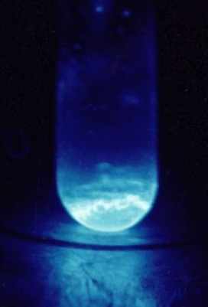
Looking for anomalous jumps…
Beryllium is 50% stronger than steel
Liquid-fuel rockets use nozzles of pure beryllium
Europium is used to identify counterfeit Euros
Ytterbium is used to make flexible (fiber) lasers
Einsteinium produces 1000W of heat per gram

Slide 29


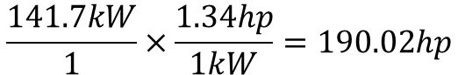
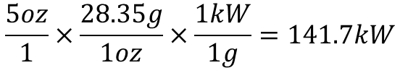
How Energetic is Einsteinium?
5 oz
190 hp
2019 Mazda Miata
$$\frac{5oz}{1}×\frac{28.35g}{1oz}×\frac{1kW}{1g}=141.7kW$$
Einsteinium produces 1000W of heat per gram
$$\frac{141.7kW}{1}×\frac{1.34hp}{1kW}=190.02hp$$

Slide 30
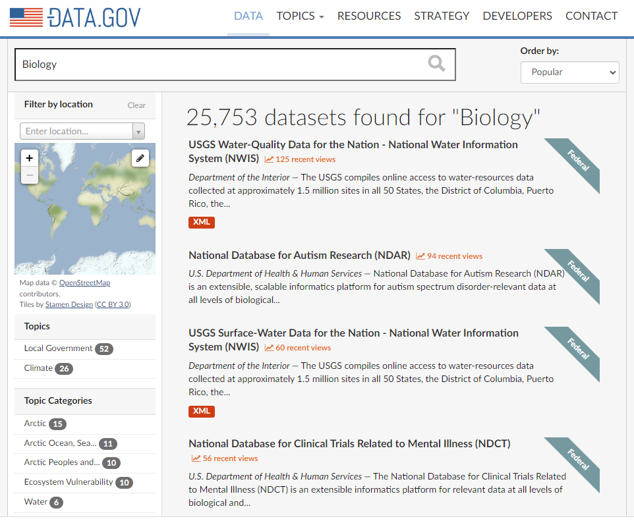
DATA.GOV
https://catalog.data.gov

Slide 31
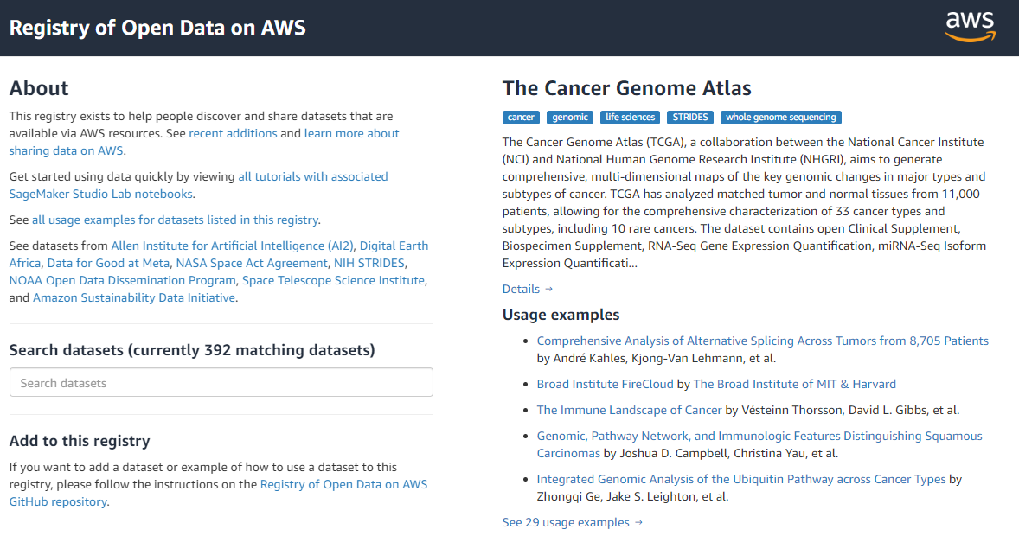
Amazon Open Data Sets
https://registry.opendata.aws

Slide 32
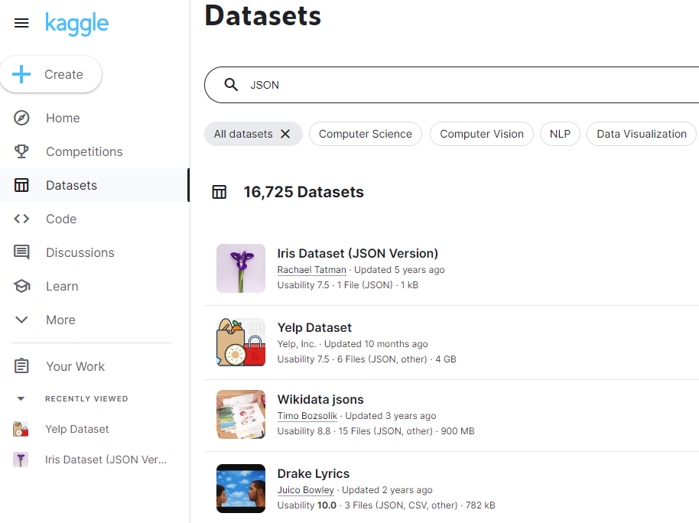
Kaggle
https://www.kaggle.com/datasets

Slide 33
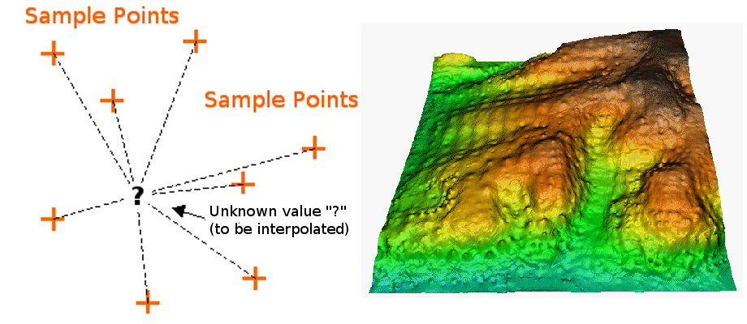
Interpolating Spatial Data

Slide 34
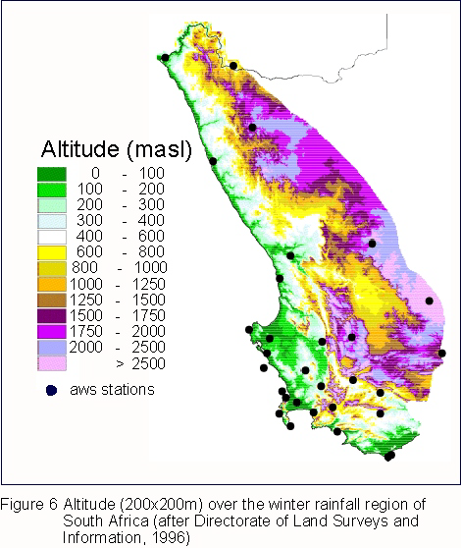
Interpolating Spatial Data

Slide 35
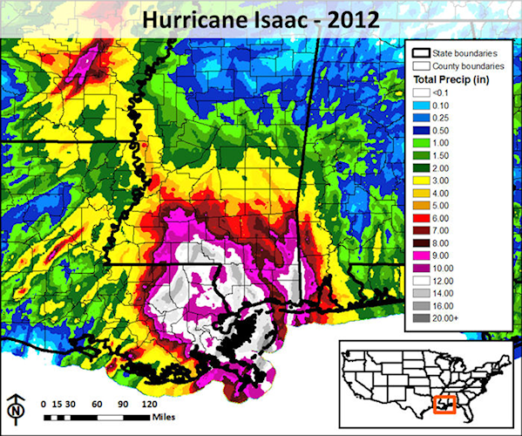
Interpolating Spatial Data

Slide 36
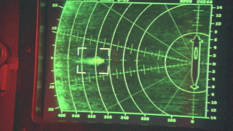
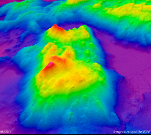


Interpolating Spatial Data
Jonsey Reports

Slide 37
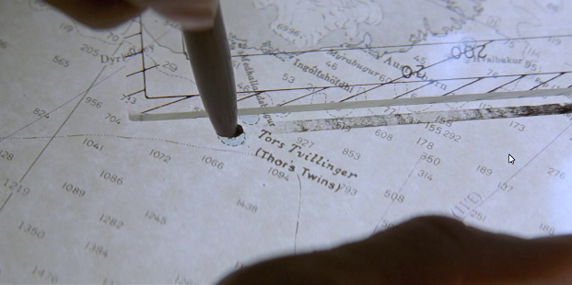
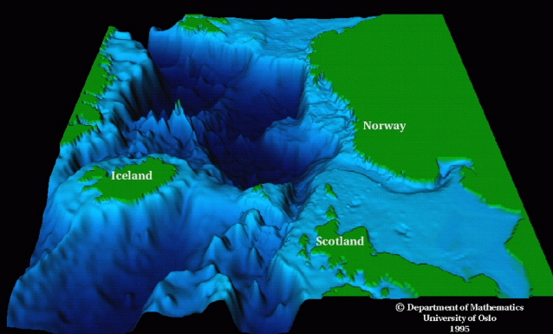
Interpolating Spatial Data
Modi (Brave) and Magni (Strong)

Slide 38
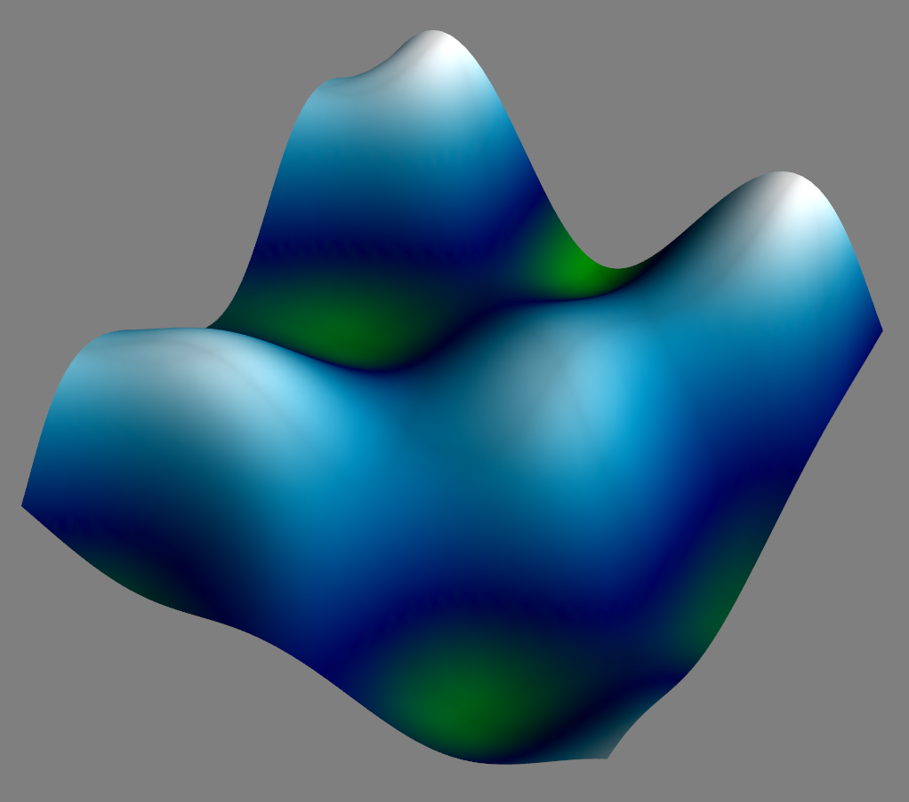
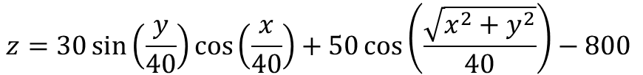
An “Actual” Ocean Floor
$$z=30\sin\left(\frac{y}{40}\right)\cos\left(\frac{x}{40}\right)+50\cos\left(\frac{\sqrt{x^{2}+y^{2}}}{40}\right)−800⁡$$

Slide 39
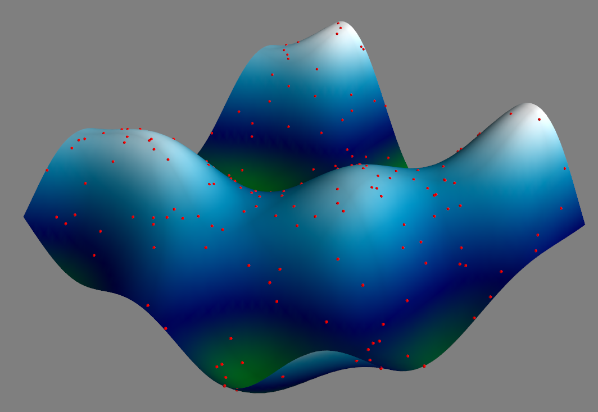
Sample Ocean Depth Soundings
Ocean area is a square, 390 units to a side (152,100 total units)
The area is subdivided into 65 intervals per side (4,225 total intervals)
Depth samples (sonar timings) were taken from 220 random locations

Slide 40
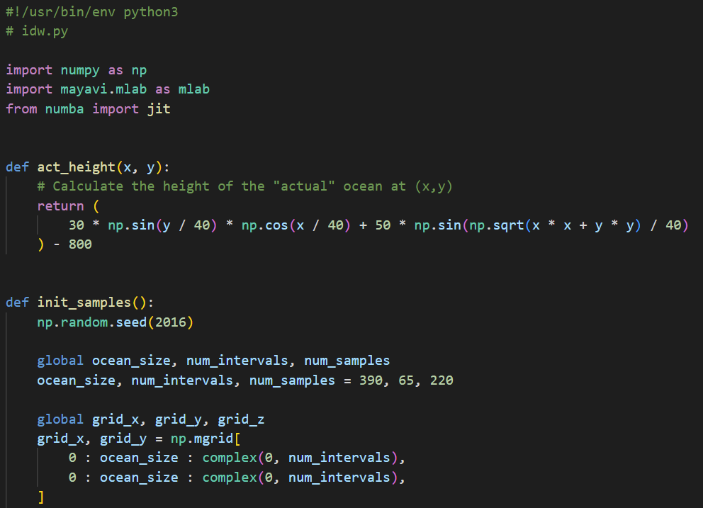
Open idw.py
①

Slide 41
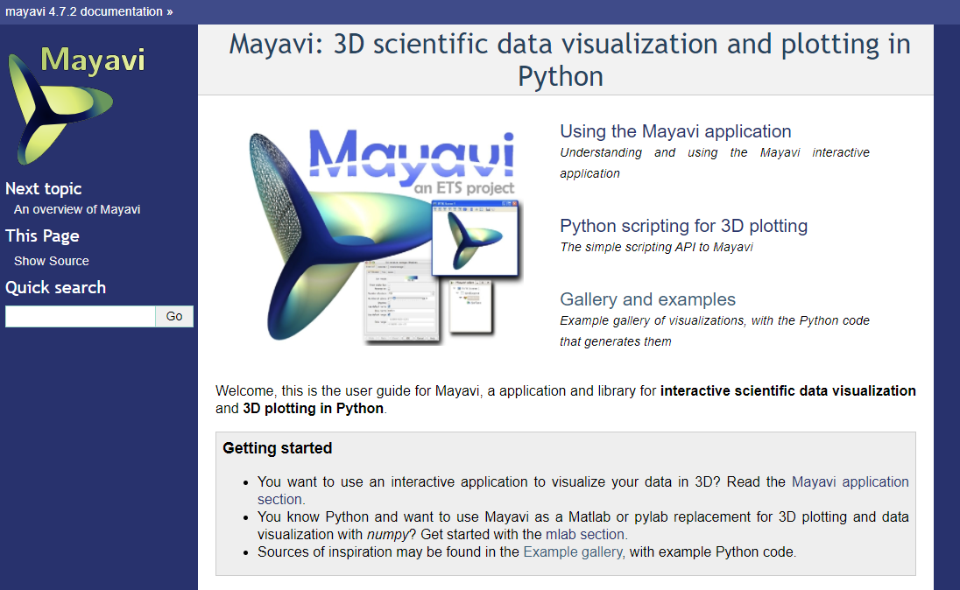
https://docs.enthought.com/mayavi/mayavi

Slide 42
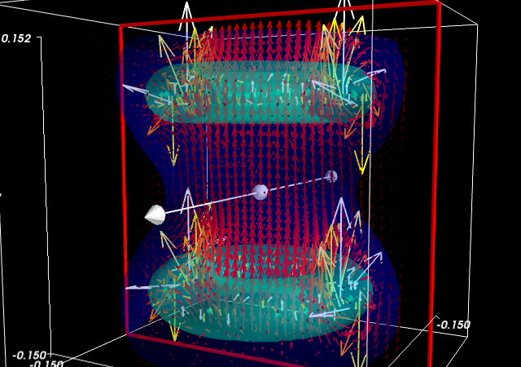

Slide 43
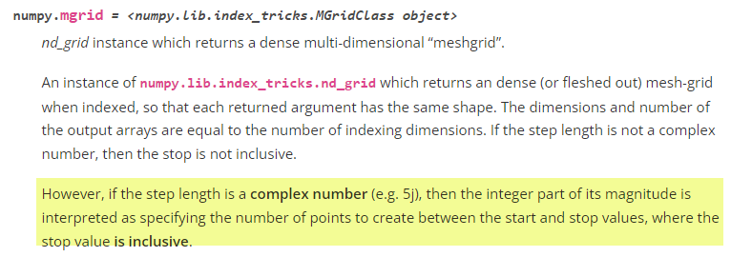
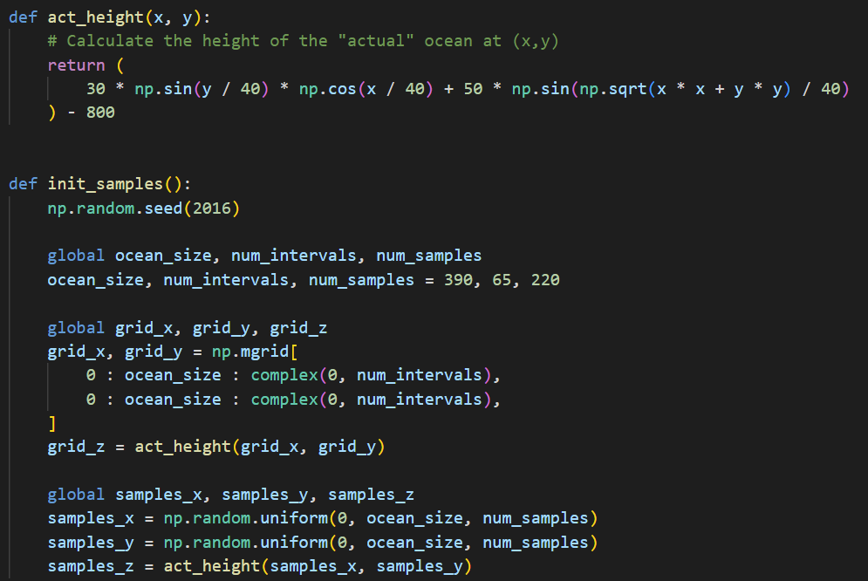
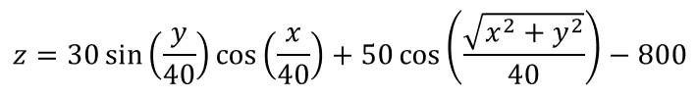
View idw.py
①
②
③
THIS IS AN UGLY HACK!
④
⑤
⑥
⑦
We would not normally know this!
⑧
⑨
⑩

Slide 44
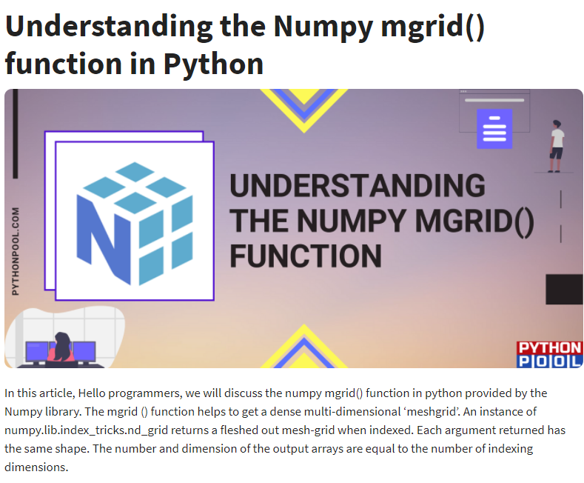
https://www.pythonpool.com/numpy-mgrid

Slide 45
The Inverse Distance Weighting (IDW) Method
IDW is a type of deterministic method for multivariate interpolation of a set of scattered points
The value assigned to unknown points are calculated from a weighted average of the values at the known points
The theory is the farther away a known point is from the unknown point, the less that known distant point can contribute to the unknown height
Closer known points contribute more to the unknown height than known points that are farther away
Your contribution is inverse to your distance

Slide 46
The Inverse Distance Weighting (IDW) Method
75
X
25
5
10
2
10
2
1
3
$\left(\frac{17.5}{0.8}\right)$→

Slide 47
The Inverse Distance Weighting (IDW) Method
75
X
25
5
10
2
10
2
1
3
$\left(\frac{17.5}{0.8}\right)$→

Slide 48
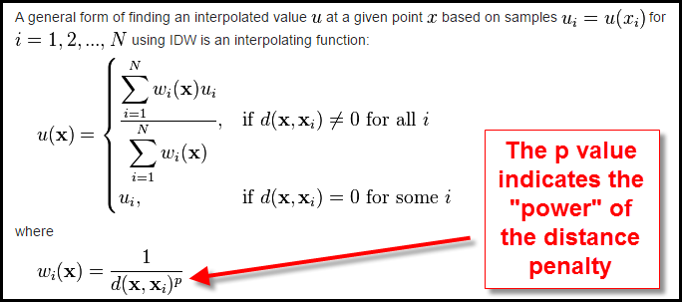
The Inverse Distance Weighting (IDW) Method

Slide 49


SciComp As Translational Science
"The algorithm that almost won the cold war"
11 lines of code can change the world!
SciComp is the ability to translate mathematical expressions of scientific concepts into correct and efficient software code

Slide 50

View idw.py
①
②
③
④
⑤
⑥
⑦
⑧
⑨

Slide 51

View idw.py
⑤
⑥
Actual Sea Floor
⑦
Estimated Sea Floor
⑧
⑨
⑩
①
②
③
④

Slide 52

Run idw.py
Left Click Drag = Rotate
(Yaw & Pitch)

Slide 53

Run idw.py
CTRL (CMD) + Left Click Drag = Roll

Slide 54

Run idw.py
Right Click Drag = Zoom

Slide 55

Run idw.py
Close window to return to VSCode

Slide 56

Edit idw.py
Set plot type to 2

Slide 57


Run idw.py
$$p=2.0$$

Slide 58

Run idw.py
The surface does not meet many of the samples

Slide 59


Edit idw.py
Set $p=5.0$

Slide 60


Run idw.py
$$p=5.0$$
The surface seems to touch more samples

Slide 61


Edit idw.py
Set $p=9.0$

Slide 62


Run idw.py
$$p=9.0$$
The surface seems artificial (overfitted)

Slide 63

Edit idw.py
Set plot type to 3

Slide 64

Run idw.py
Blue = Act
Red = Est

Slide 65


Root Mean Square Deviation
As we increase the power term p, is our model getting better or worse at predicting reality?
The root-mean-square deviation (RMSD) is a statistic to measure the difference between the values predicted by a model versus the observed values
By averaging the errors ${(actual−estimated)}^{2}$ across all sample points, we calculate a comparative statistic that can help empirically determine the optimal p value because it will minimize the overall error of the model
$$RMSD=\sqrt{\frac{\sum_{t=1}^{n}{{\left(\hat{y_{t}}−y\right)}^{2}}}{n}}$$

Slide 66


Open idw_min_rmsd.py
④
⑤
⑥
⑦
⑧
⑨
⑩
①
②
③

Slide 67
Open idw_min_rmsd.py
①
②
③
④
⑤

Slide 68


Run idw_min_rmsd.py

Slide 69
Session 16b – Know You Know…
A dictionary in Python stores a series of key-value pairs, with the key and the value separated with a colon
Dictionary keys can be any immutable type (int, float, str, tuples) while values can be any type, including another dictionary
We can insert/delete keys and enumerate all the keys and their associated values but all keys in a dictionary must be unique
The built-in "Pretty Print" (pprint) function will display a dictionary with proper indentation, etc.
A JavaScript Object Notation (JSON) file follows the same syntax as a Python Dictionary
Numpy can easily load, parse, and save comma separated value (CSV) data files and treats them as arrays

Slide 70
Session 16b – Know You Know…
The Inverse Distance Weighting (IDW) method can interpolate multi-dimensional data taken from random sample locations
How to convert non-uniformly measured spatial data into a regular conforming mesh
How to use RMSD as one metric to characterize the “goodness of fit” for predicted interpolated data points
Scientists rarely enjoy the luxury of having too many data samples and must often interpolate to fill in the missing gaps in their observations

Slide 71



Task 16-02
Cosmic rays entering the Earth's atmosphere collide with gas molecules creating secondary particles
Your scientist has developed an instrument to capture the trajectory of these secondary particles as they rain down and has given you a data file (ray.csv) of an individual particle's height (in centimeters) over the final nanoseconds before its impact
The scientist knows the secondary particle was not accelerating in his detector and lived for only 0.1743 milliseconds and now he wants you to determine its velocity (relative to $c$) and the height (in km) in the stratosphere at which it was originally emitted
Create plot_trajectory.py to display the particle's path and the line of best fit to determine the two unknowns
Upload your solution to the BNL QIS101 SharePoint site

